Slide 1
Biological evolution of hominins
Trends in Human Lineage

Slide 2
The earliest hominins
Australopithecines: The ancestors of modern homo sapiens???

Slide 3
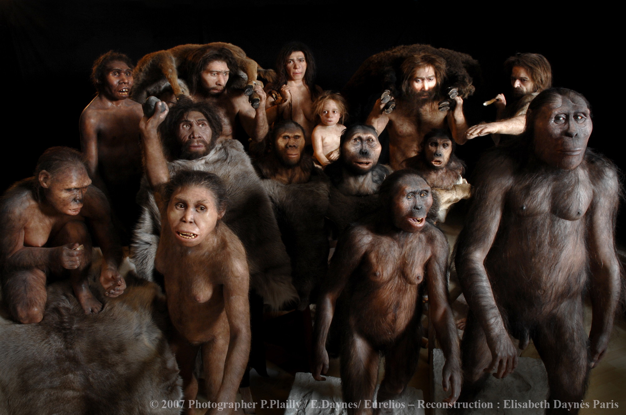

Slide 4
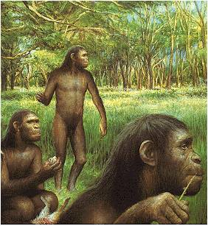
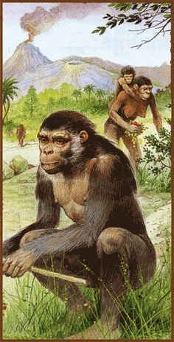
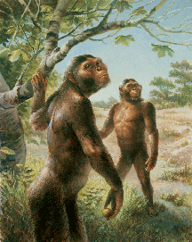
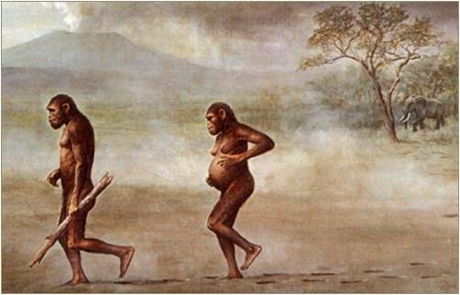
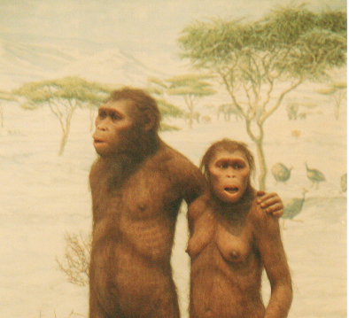

Slide 5
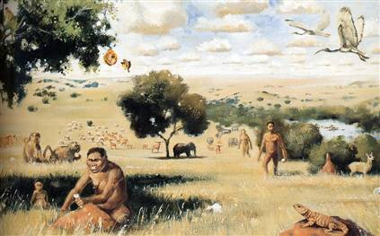

Slide 6
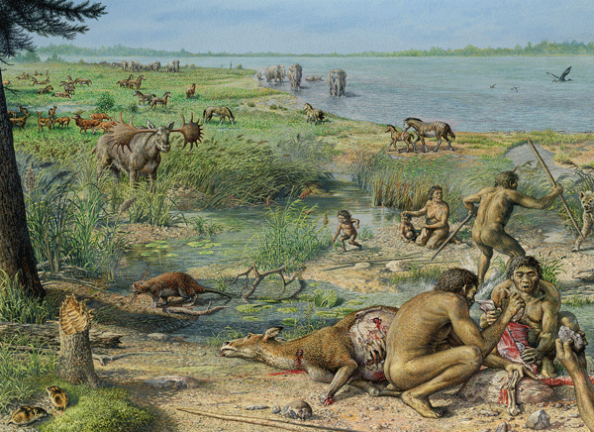

Slide 7
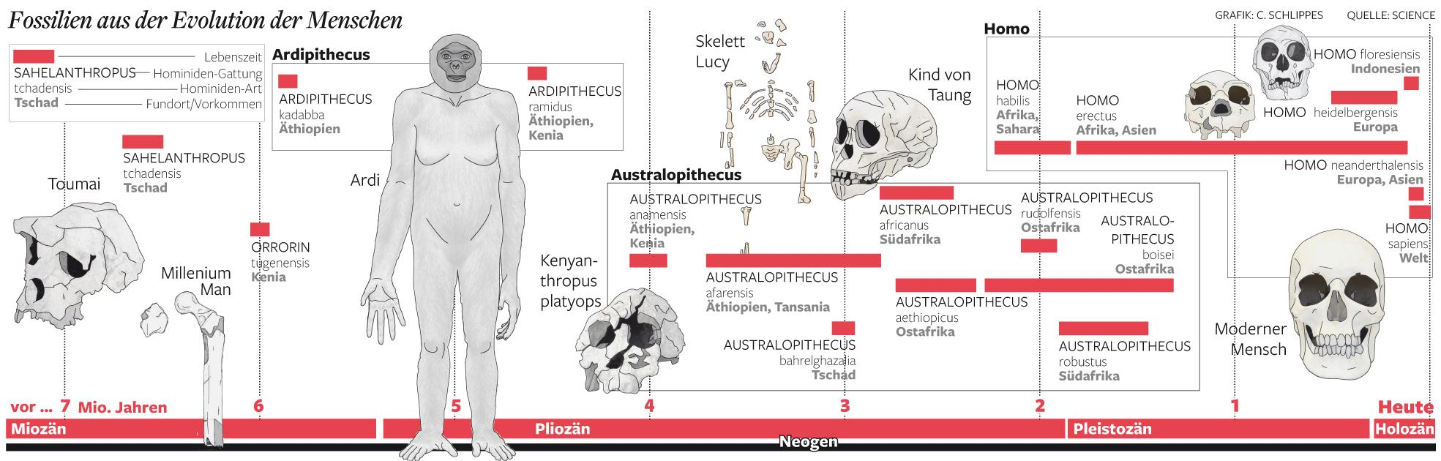
Our ancestors
Fossil evidence has told us a lot about the history of hominins.
What early hominins locomotion was like, what they used to eat, whether they used or created tools, what social structure and communication skills they had....

Slide 8
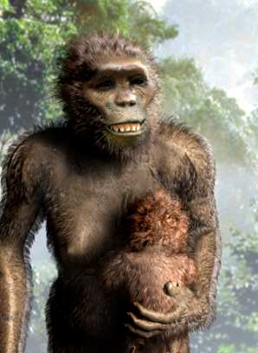
Genus Australopithecus
The Australopithecines are early hominins existing between 4.4-1.2 mya.
There are up to 10 species and three genera (Australopithecus, Ardipithecus, Paranthropus), depending on the view of the particular paleoanthropologist.
They are the first known habitually bipedal primates
(mixed skeletal traits suited for arboreal and bipedal locomotion)
Suited to herbivorous diet
Small brains.
No evidence of stone tool use.
Draw a rough timeline of these early hominins.
Ardipithecus ramidus (4.5-4.2 mya)
Australopithecus anamensis (4.2-3.8 mya)
Australopithecus afarensis (3.9-3 mya)
Australopithecus africanus (3-2.3 mya)
Australopithecus / Paranthropus robustus (2.2-1.5 mya)
Australopithecus / Paranthropus boisei (2.2-1 mya)

Slide 9
Biological evolution
Complete the following table using info in the following slides or from your textbook to show trends in biological evolution
 | A.ramidus | A.anamensis | A.afarensis | A.africanus | A.robustus & A.boisei
Time period
Brain size (cm³)
Diet
‘Human like’ skeletal features
‘Ape like’ skeletal features
Locomotion

Slide 10
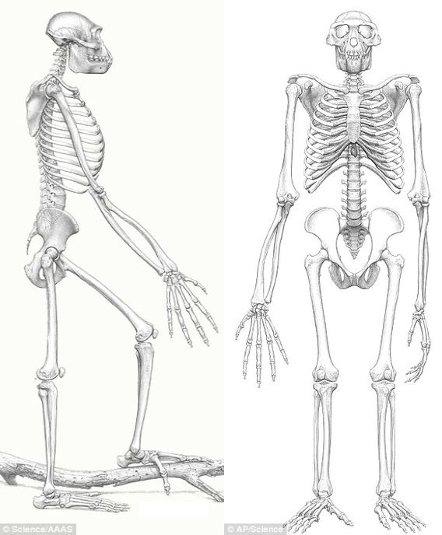
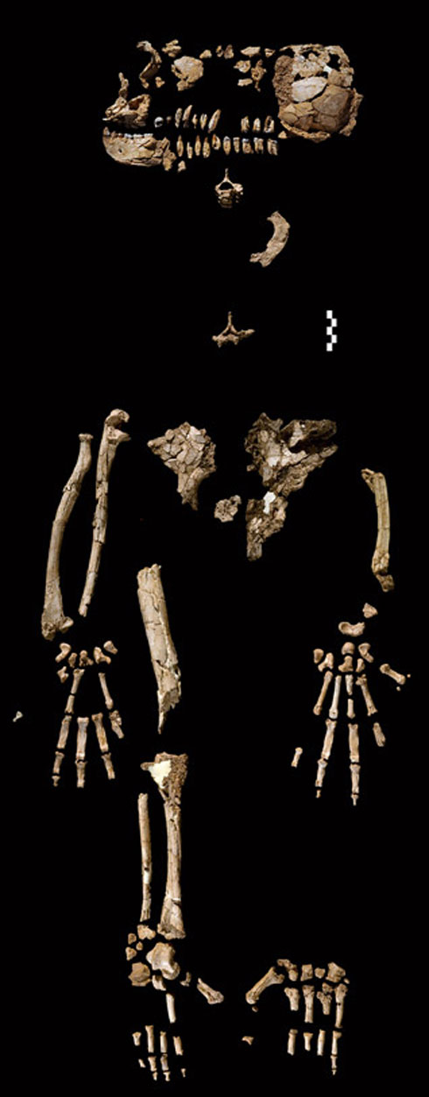
Ardipithecus ramidus
(4.5-4.2 mya)
Fossil remains (Ethiopia) show a mixture of ape-like and human features.
The foramen magnum is sufficiently forwardly placed in the skull to indicated bipedalism
Pelvis adaptations for bipedalism as well as tree climbing
Foot has an opposable big toe
Comparatively long arms.

Slide 11
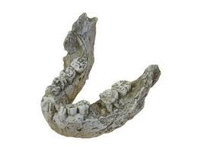
Australopithecus anamensis
(4.2-3.8 mya)
Fossil remains (Kenya), include mostly teeth and some postcranial bones one tibia found.
tibia (shinbone) suggests bipedalism.
large canine teeth
jaws more parallel like apes

Slide 12
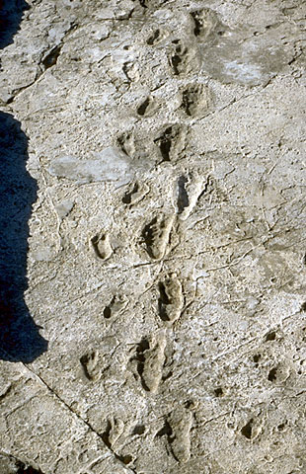
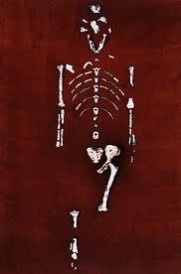
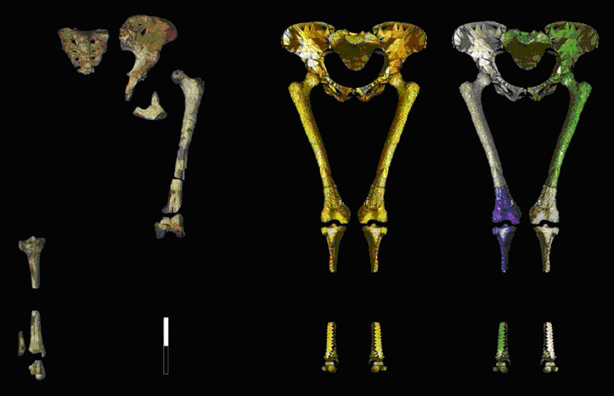
Australopithecus afarensis
(3.9-3 mya)
An 40% complete skeleton was found in Ethiopia in the 1970s and came to be known as ‘Lucy’.
‘Lucy’ and other fossil evidence gave clear evidence of full bipedalism. There are also primitive features:
small brain 440cm³, similar to chimp
large canine teeth with diastema present
Long arms relative to legs
Increased valgus angle
jaws more parallel like apes
long and slightly curved finger bones.
Prognathism (jutting out of lower face).
Receding chin
Footprints showing bipedalism

Slide 13
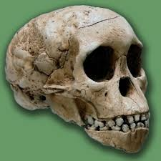
Australopithecus africanus
(3-2.3 mya)
Fossil remains (South Africa), included the skull of a child about 3-4 years old named the ‘’Taung child’.
Foramen magnum indicated bipedalism
Small canine teeth without a diastema
parabolic-shaped jaw more human than apelike
Small brain 440cm³
Hip girdle more humanlike than apelike

Slide 14
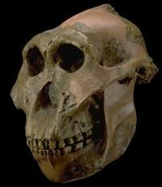
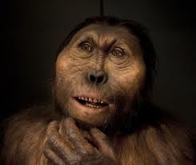
A.robustus (2.2-1.5 mya)
A.boisei (2.2-1 mya)
These two species are placed in the Australopithecus genus by many scientists and the genus Paranthropus by all the others.
They are more robust (heavily built) than the other Australopithecine species.
heavy skull with massive molars and premolars
large sagittal crest
large zygomatic arch indicating large jaw muscles for eating tough fibrous plant material (hence the given name ‘nutcracker man’ for A.boisei)

Slide 15
Which was our ancestor?
It is generally agreed that:
A.anamensis and A.afarensis were likely to have been ancestral to Homo genus
A.ramidus was likely to have been close to the ancestor of both humans and apes
Australopithecus/Paranthropus robustus and boisei were specialised herbivorous forms that were evolutionary dead ends; i.e left no present-day descendants.

Slide 16
The later hominins
Homo genus: The other homo species and H. sapiens

Slide 17
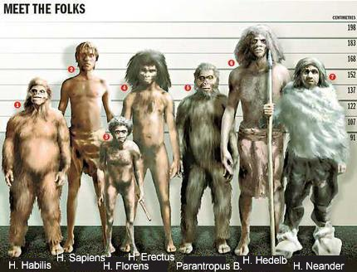
Genus Homo

Slide 18
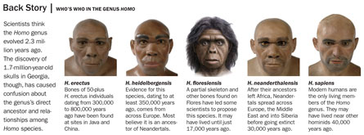
Genus Homo
The Homo genus came into existence approximately 2.5 mya.
There have been many species in this genus, but only one species, ours, Homo sapiens, survives. Other species we know of were; H. habilis, H. ergaster, H. erectus, H. floresiensis, H. antecessor, H. georgicus, H. heidelbergensis, H. neanderthalensis
With the genus Homo there was a sudden leap in brain size, a change in anatomy and the beginnings of stone tool culture and other cultural advances.

Slide 19
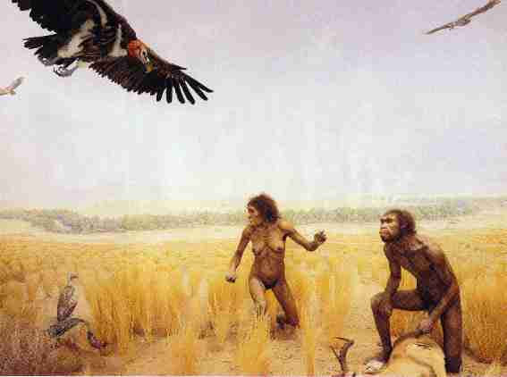
Another climate change
At about 2.5 mya (when Homo genus first came to exist), Africa underwent more dramatic climate change, and the habitat that had been occupied by early hominins became more open and arid.
This led to a change in the type of plant species that were successful - tougher foods that could withstand the drier conditions, such as roots and tubers became more prevalent.

Slide 20
Biological evolution
Complete the following table using info in the following slides or from your textbook to show trends in biological evolution
 | H. Habilis/ H.rudolfensis | H. ergaster/ H. erectus | H.heidelbergensis | H.neanderthalensis | H.sapiens
Time period
Brain size (cm³)
Height
Skull features
Other skeletal features

Slide 21
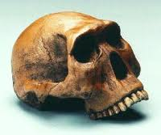
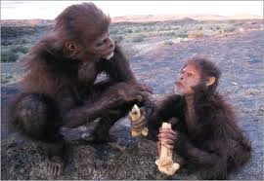
H. habilis / H. rudolfensis
(2.3-1.44 mya)
Homo habilis is almost transitional between the Australopithecines and Homo species.
Had a body with longer arms like Australopithecines, but a more human like face that was longer and narrower and less protruding.
Its teeth were smaller with a lighter jaw curved more like modern humans. It’s skull was more rounded.
It’s brain size was about 600-800 cc, about 50% bigger than Australopithecines, but still smaller than modern humans (1000-1800 cc).
About 1.3m tall.
H.habilis either lived at the same time as H. rudolfensis (more robust) or they may be the same species.

Slide 22
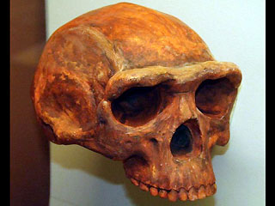
H. ergaster/ H. erectus
(1.9 mya - 100,000ya)
Whether H. ergaster and H.erectus are two species or one is uncertain. H. ergaster (who remained in Africa) may have diverged from H. erectus (who migrated to Asia), or they may be different populations of the same species, H. erectus, living in different areas.
The African population is believed to be the ancestor of later Homo species H. heidelbergensis, H. neanderthalensis and H. sapiens (us).
Both contained a larger brain than H. habilis of 750 - 1250 cc
About 1.6m tall.
They had a flatter face but large brow ridges, large jaw and no chin.

Slide 23
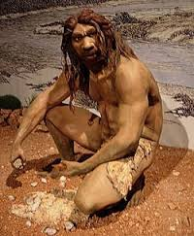
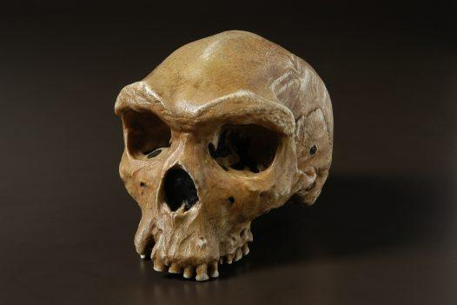
H. heidelbergensis
(600,000-400,000ya)
Descendant of H. ergaster/erectus.
They had a prominent brow ridge (but smaller than H.erectus).
Tall at 1.8m on average and more muscular than modern humans (some were believed to be up to 2m tall with weights of 100kg)
Brain capacity between 1100-1400 cc (which overlaps that of modern humans 1000-1800 cc)

Slide 24
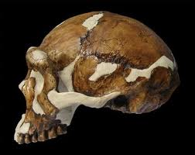
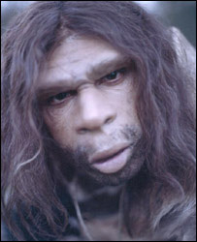
H. neanderthalensis
(400,000ya - 30,000ya)
Like modern humans, Neanderthals (pronounced with a silent h, ‘Nee-an-der-tal’), were members of the Homo genus. They looked different because they evolved in cold (European) climates and had adaptations to conserve heat.
Short stocky bodies that were very muscular.
Large head with huge projecting nose and deep set eyes under a prominent brow ridge and a sloping forehead.
Averaged heights of 1.5-1.7m tall.
Largest brain capacity of homo species of 1500 cc.

Slide 25
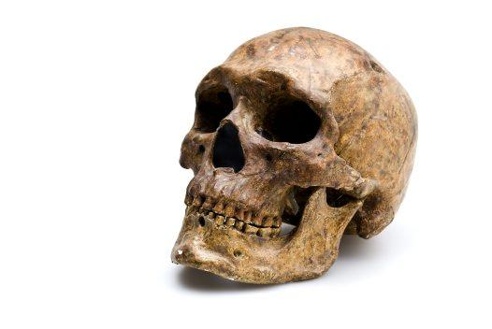
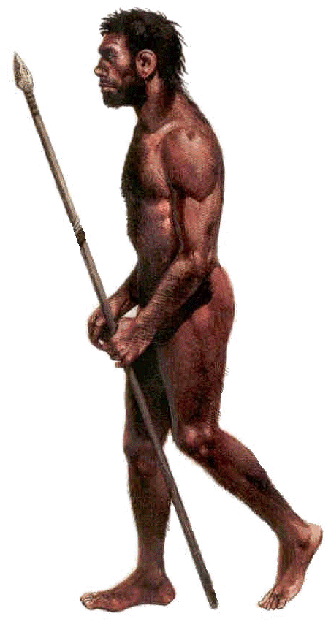
H. sapiens
(200,000 ya - present)
Anatomically, modern H.sapiens evolved from H. heidelbergensis in Africa.
Due to warmer climates, unlike the Neanderthals, H. sapiens are tall and lanky with a more gracile (lightly built) skeleton.
Height varies from 1.5-1.8m.
Brain capacity ranges from 1000-1800 cc
We have a flat rather than sloping forehead with only a slight brow ridge. Small nose and jaw with a definite chin.
Jaw is v shaped with small uniform teeth suited for omnivorous diet.
Want to know more? Look in the mirror.

Slide 26
